Slide 1
TCU Panhellenic Recruitment Parent & Family Orientation 2019

Slide 2
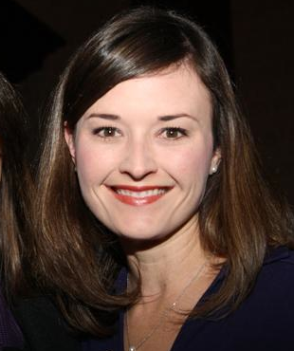
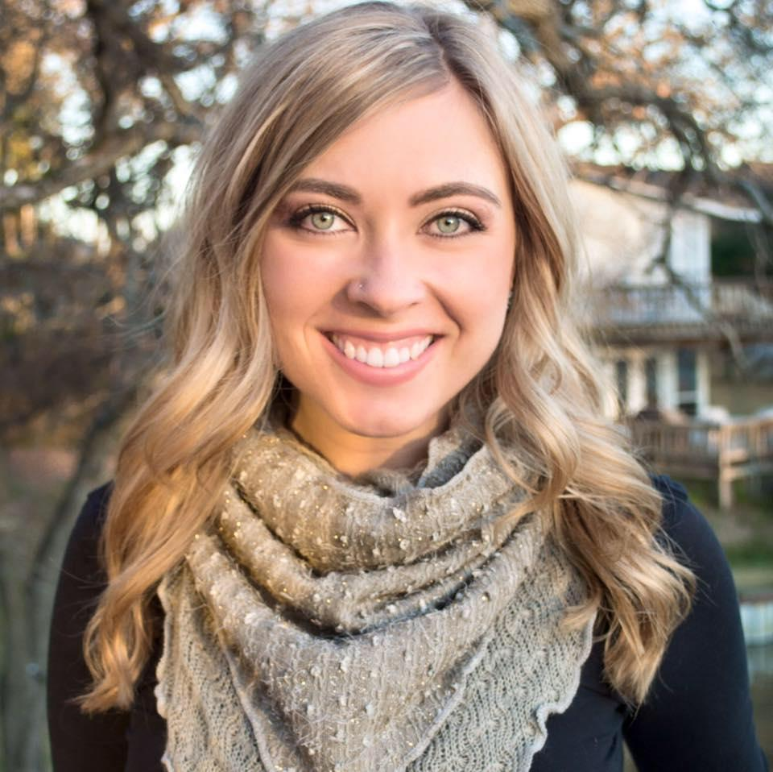
Meet the Staff
Brooke Scogin
Director, Fraternity & Sorority Life
Devin Wimberly
Assistant Director, Fraternity & Sorority Life
Panhellenic Advisor
Notes:
Change to Wimberly

Slide 3
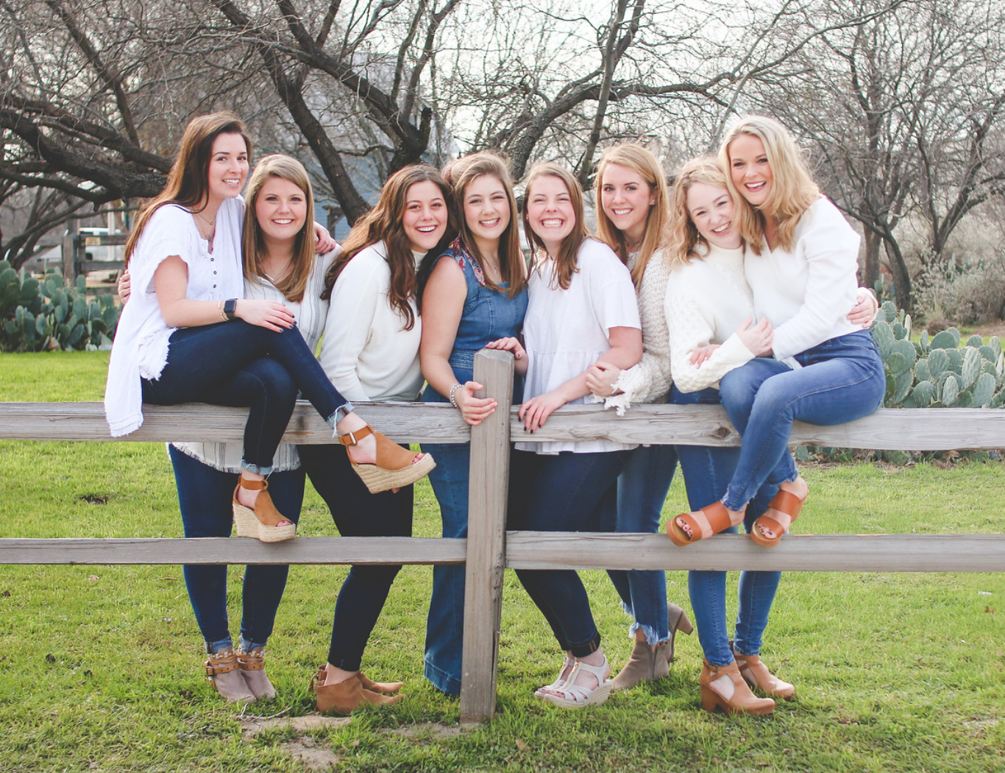
2019 TCU Panhellenic Executive Board

Slide 4
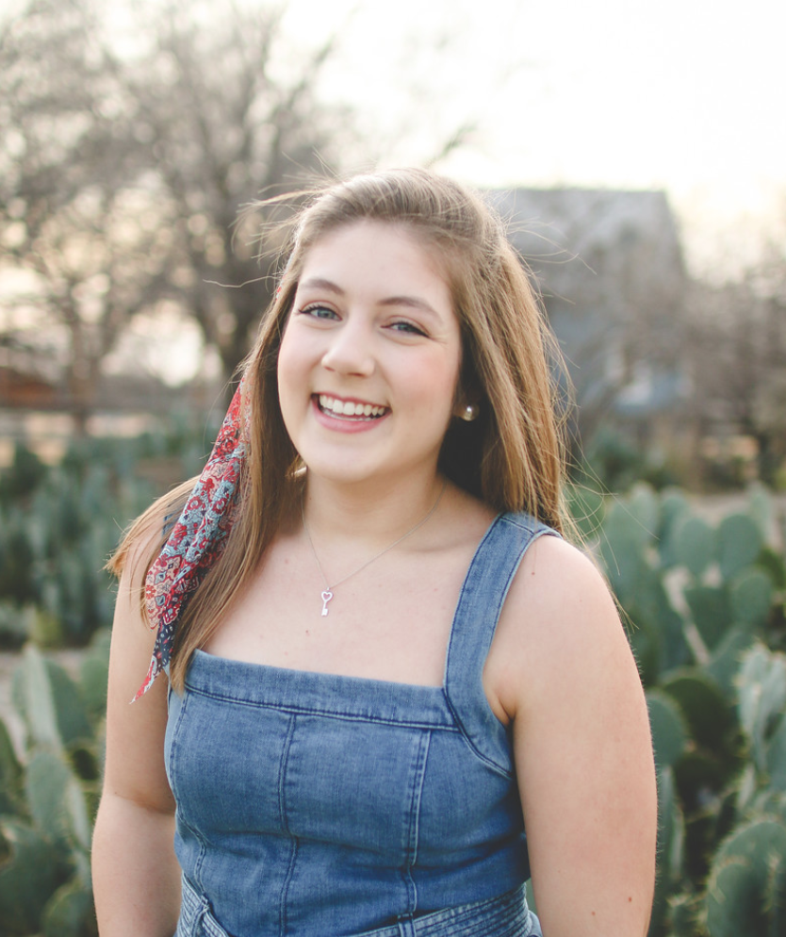
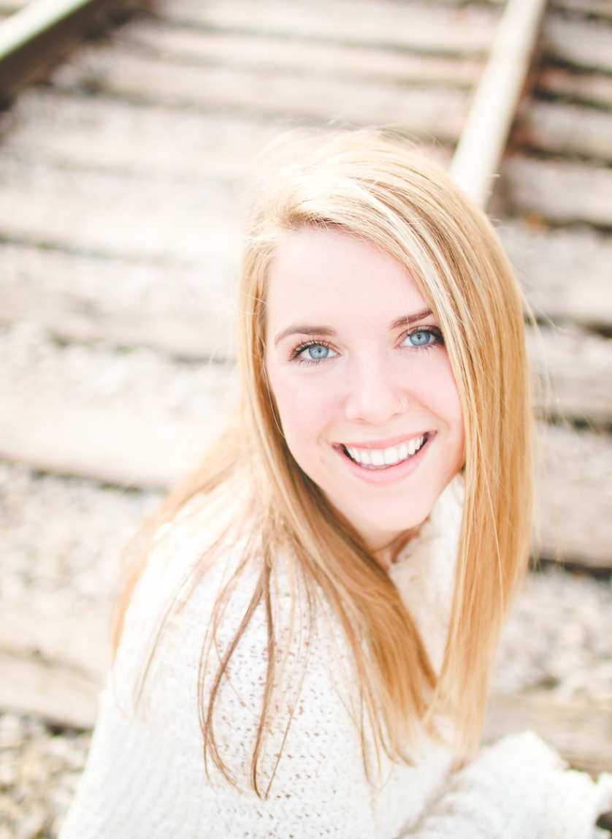
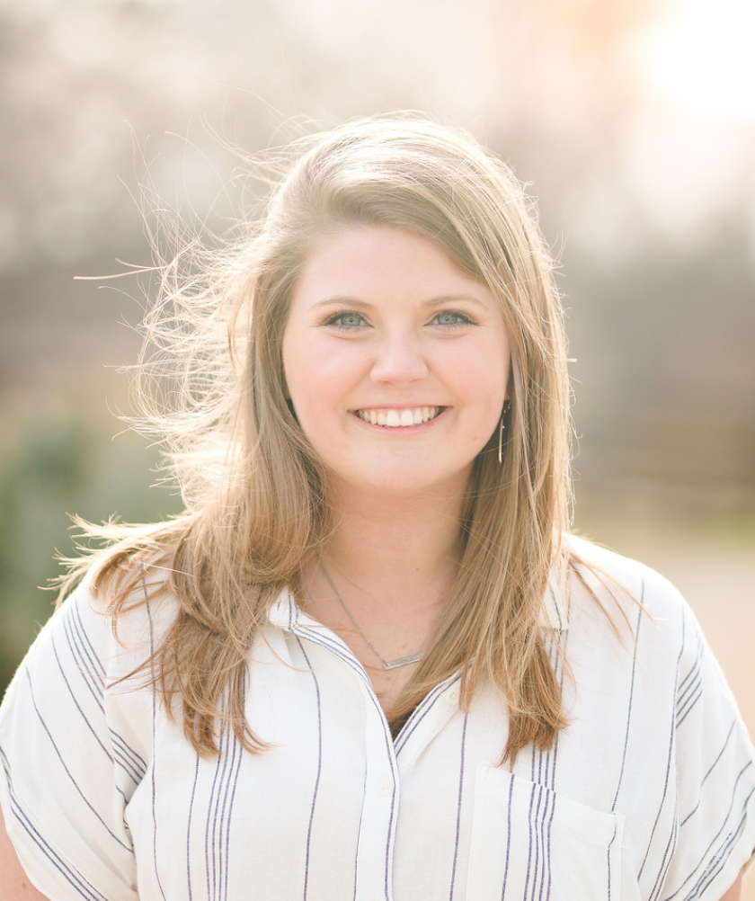
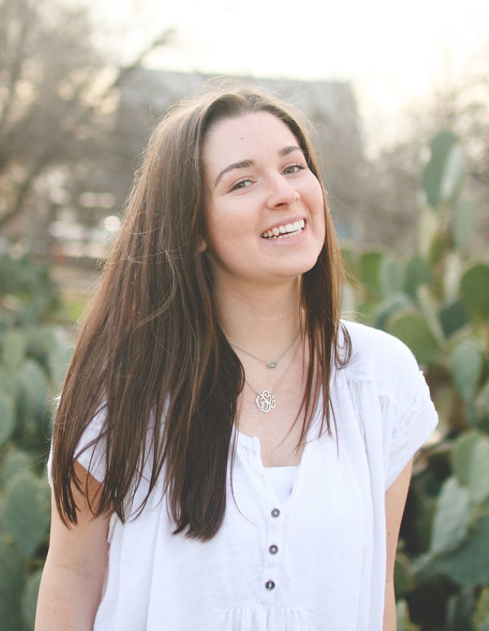
Meet the Recruitment Team
Fontana Frazier
President
Audrey Spiller
VP of Recruitment Programming
Alexis Hodge
VP of Recruitment Operations
Claire Simpson
VP of Management

Slide 5
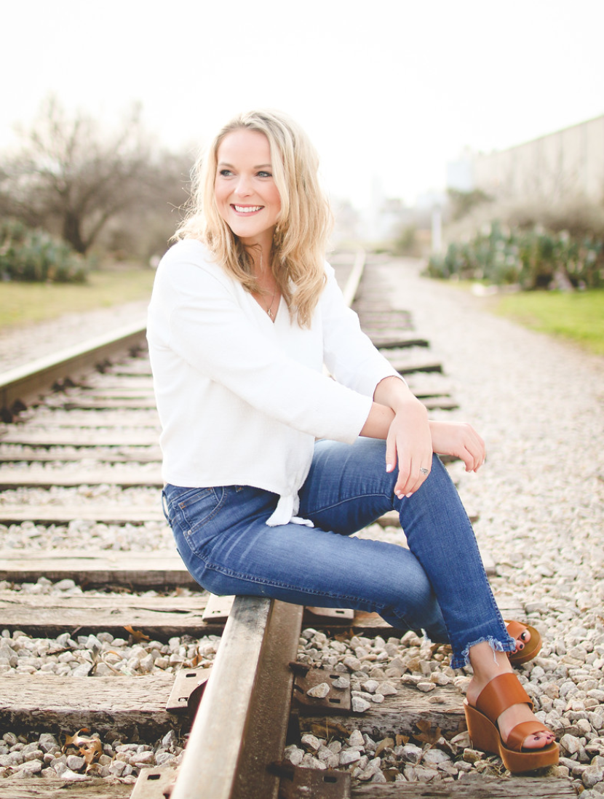
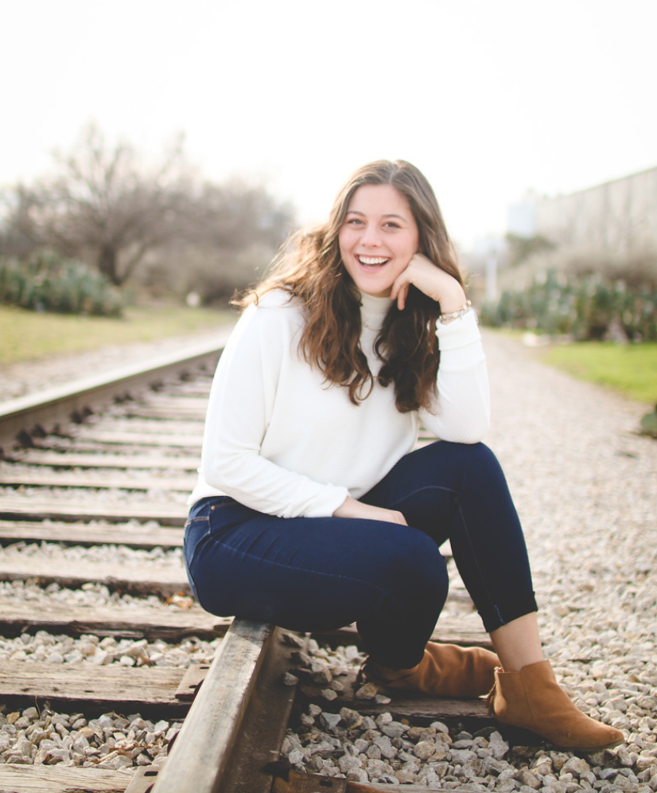
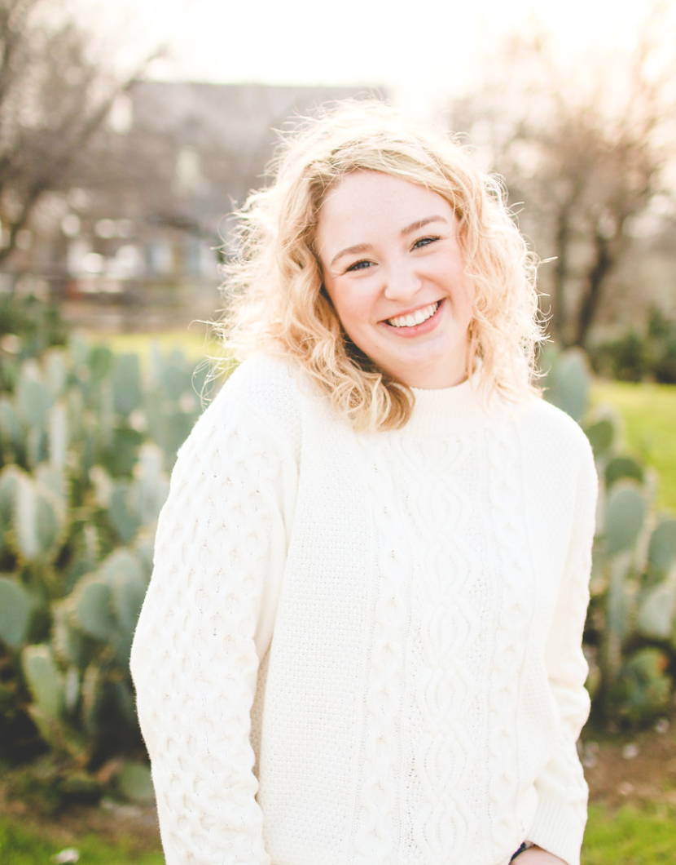
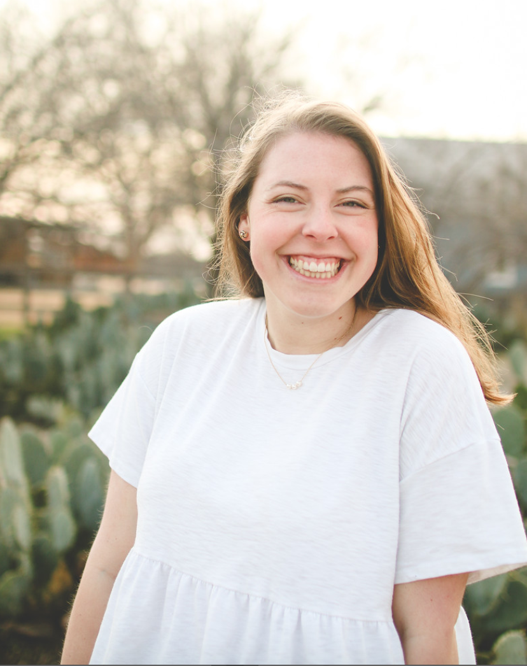
Meet the Recruitment Team
Brittney Larkin VP of Finance & Administration
Kat Miro
VP of Member Development
Jayne Kernodle
VP of Public Relations
Suzanna Camp
VP of Service &
Philanthropy

Slide 6
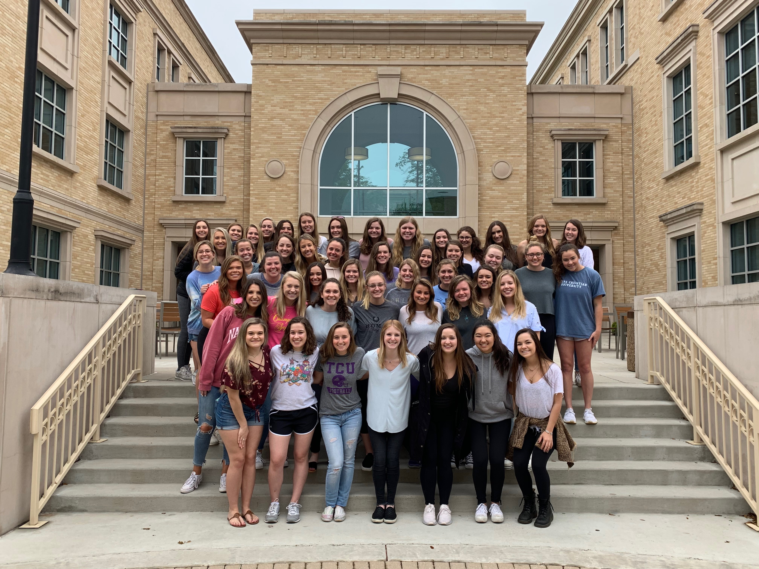
Meet the Rho Gammas (Recruitment Guides)

Slide 7
Agenda
What is a sorority?
Basic Terms
Requirements to Participate
Week at a Glance
Event Structure and Priority Preference
Things to Know: Special Schedules, MRABA, What to Wear and Contact Information

Slide 8
What is a Sorority?
General Fraternities and Sororities were established in the eighteenth century and are commonly called “social” fraternities/sororities. Other fraternities are honor societies, and not joined through mutual selection
Fraternities & Sororities have been recognized at TCU since 1955
Our organizations are formed with the goals of contributing to the collegiate development of members
Focus on academics
Promote community service and philanthropy

Slide 9
Basic Recruitment Terms
Potential New Member (PNM)
Your daughter!
Priority Preference
Process used for selection
Fraternity/Sorority
Women’s fraternities are commonly referred to as sororities
National Panhellenic Conference (NPC)
The umbrella organization for 26 (inter)national sororities
Active
An initiated member of a chapter
Sister
What actives refer to each other as
Philanthropy
The act of donating to a person’s/group’s values

Slide 10
Requirements to Participate in Panhellenic Recruitment
Must be registered for recruitment through TCU Panhellenic
Must be enrolled as a full time student
Must have at least a 2.0 cumulative GPA
**Scholarship is a top priority among our organizations.
Each chapter sets their own minimum GPA requirement for membership and that requirement is typically significantly higher than a 2.0.
Women whose cumulative GPA falls below the individual chapter requirements may have a less than desirable recruitment experience.
It is important to note that neither TCU Staff nor TCU Panhellenic Officers can predict recruitment outcomes.**

Slide 11
Requirements to Participate in Panhellenic Recruitment
As a part of a greater TCU measles prevention plan, all students who do not have proof of two MMR vaccines on file with the Health Center were contacted this summer and asked to either update their records, provide laboratory evidence of immunity, or get the required two MMR vaccinations (28 days apart).
Students will not be able to participate in Panhellenic recruitment if the Health Center does not have their medical form and proof of MMR verification on file.
Students cannot participate in recruitment if they are ill or have any potential signs of illness (i.e. fever, rash, etc.), unless they are cleared by a medical professional.

Slide 12
Week in Review
PNM Orientation: Tonight at 8:00pm in the Schollmaier Arena
Scholarship Round, Part 1: Sunday, August 18th, 2019
Scholarship Round, Part 2: Monday, August 19th, 2019
Service/Philanthropy Round, Part 1: Tuesday, August 20th, 2019
Service/Philanthropy Round, Part 2: Wednesday, August 21st, 2019
Leadership Round: Thursday, August 22nd, 2019
Sisterhood/Preference Round: Friday, August 23rd, 2019
Mandatory Frogs First Activities: Saturday, 24th, 2019
Bid Day: Sunday, August 25th, 2019

Slide 13
About the Events
PNMs must attend the maximum number of events she is invited to attend.
Any PNM who misses an event without an excuse is removed from the recruitment process and may not continue.
The number of chapters a PNM may visit each day gets smaller while the length of each event gets longer. This enables both the PNMs and the chapters to make informed decisions when it comes to selection.
The theme of the events becomes more serious as the week goes on. By preference, the chapters will be showcasing ceremonies sharing stories that are important to their sisterhood.
If a PNM does not have a full schedule, she will have a “break round” where she will relax while waiting for her next event.
It is not uncommon for a PNM to have a less than full schedule.
Every PNM will have breaks in their schedule because of the way our master schedule is structured.

Slide 14
What Happens Each Day?
Your student will come to the Schollmaier Arena every morning (except Preference Round) for a meeting and should arrive on time!
At the start of each round, women will find out which chapters they will be visiting and then go with Rho Gammas to the chapters.
At the end of each round, they will return to the Schollmaier and complete the priority preferencing process.

Slide 15
Priority Event Structure
Round One: PNMs will visit all 13 chapters over the course of two days
Round Two: PNMs will visit up to 10 chapters over the course of two days
Round Three: PNMs will visit up to 6 chapters
Round Four: PNMs will visit up to 2 chapters

Slide 16
Priority Preference Process
Priority preference is the process we will use each day to indicate selections. Each PNM will have an opportunity to “cluster” the chapters that she visited that day.
Example: on Days 1 & 2 (Round 1), she will visit all 13 chapters. On Days 3 & 4 (Round 2), she can visit a maximum of 10 chapters, so her priority preference card might look like this…
1. Chapter A
1. Chapter B
1. Chapter C
1. Chapter D
1. Chapter E
1. Chapter F
1. Chapter G
1. Chapter H
1. Chapter I
1. Chapter J
2. Chapter K
3. Chapter L
4. Chapter M

Slide 17
Mutual Selection Process
Recruitment is a mutual selection process.
Not every PNM will have a full event schedule after round 1.
Each year, a small number of women will be released from the process.
2018: 35 released out of 997
2017: 9 released out of 896
2016: 12 released out of 976
2015: 15 released out of 1005
Notes:
Find out how many women were released last year to update this

Slide 18
Things to Know: Fraternity and Sorority Life
Community Standards displayed on our website www.greeks.tcu.edu
6 semesters worth of conduct reports
6 semesters worth of grade reports
Hazing Memorandum sent out each semester

Slide 19
Things to Know: Recruitment Process
Food, water, shelter
Clear bags will be provided for personal items.
NO CELL PHONES or watches
Rho Gammas will have beauty and hygiene supplies!
Your student may be removed from recruitment due to use of alcohol or other TCU Code of Conduct violations.

Slide 20
Special Schedules
Fontana Frazier, Panhellenic President
Consists of conflicts such as: Sports Teams, Band, Show Girls, Cheerleaders, Summer School, ROTC, etc.
If I need a special schedule, how do I arrange this?

Slide 21
PNM Code of Conduct
Document each PNM signs
Code of respect and behavior
If a PNM violates this code, she will have a meeting with the Recruitment Team and have the potential to be removed from the process

Slide 22
Infractions
Violations of Panhellenic bylaws, Code of Ethics or NPC Unanimous Agreements
Rho Gammas can get Violation Report forms if needed

Slide 23
MRABA
After Preference Round, PNMs complete the Membership Recruitment Acceptance Binding Agreement (MRABA).
PNMs will be able to see the terms of this agreement in at least 4 different formats, including in an individual conversation with a TCU Professional Staff member.
We encourage PNMs to list each chapter they attended on Preference Round because this maximizes her opportunity for membership. We want as many women as possible to join the sorority experience.
PNMs do not have to list each chapter they attended during Preference Round; however, this is called Intentional Single Preference and she may limit her opportunity for membership and not receive a bid.
PNMs should not list a sorority they would not accept a bid to membership from

Slide 24
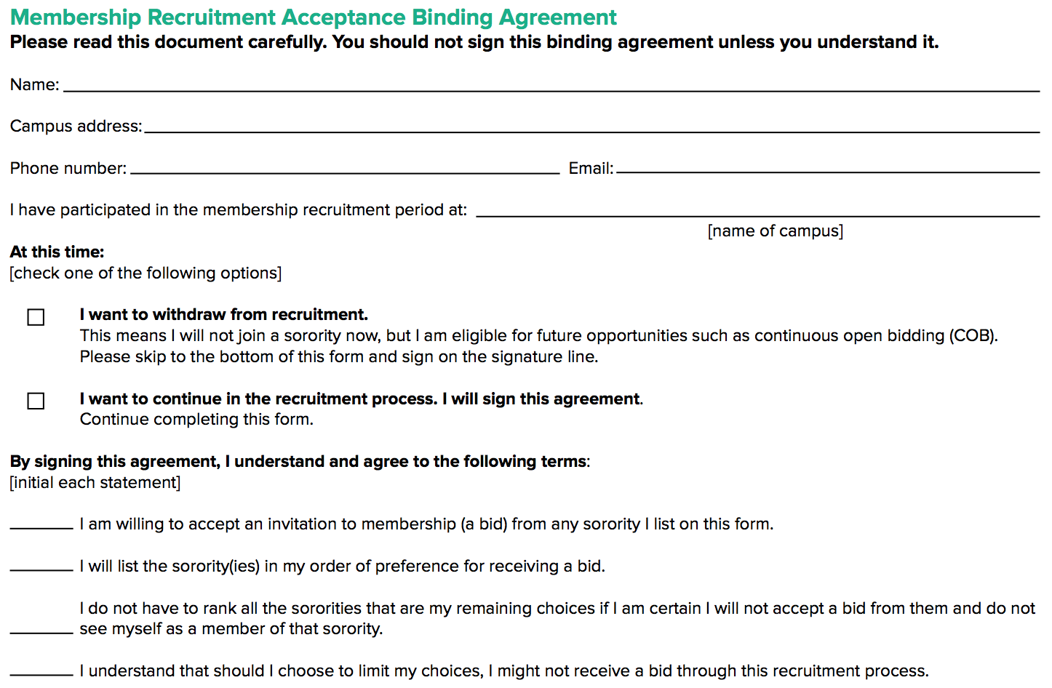
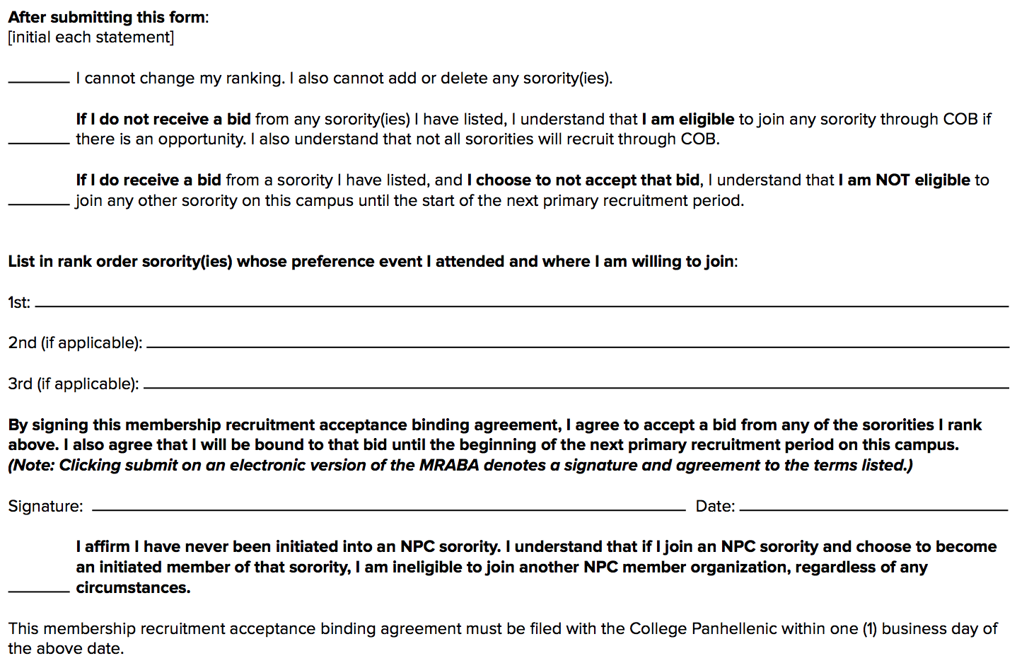
MRABA Example

Slide 25
MRABA Continued
Main points that must be understood:
Changes cannot be made once the card is submitted
PNMs must be willing to accept a bid from any of the chapters they list on their MRABA card. If a PNM is matched to a chapter during this process, she is bound until the next primary recruitment. Meaning, if she depledges or drops the organization, she cannot pledge another TCU Panhellenic sorority until August 2020.
If and ONLY if a PNM is unmatched during bid matching or withdraws PRIOR to signing her MRABA is she eligible to pledge a TCU Panhellenic sorority during the 2019-2020 school year.
There are no guarantees that any of our organizations will be open for membership, (COB) beyond the formal recruitment process.

Slide 26
Bid Day
PNMs will report to the BLUU Ballroom at 2:30pm
Rho Gammas will reveal their affiliation
PNMs will open their bid cards and join representatives from their sorority
Activities begin at 2:30pm
Alcohol free
Should parents attend?

Slide 27
What to Wear during Recruitment!

Slide 28
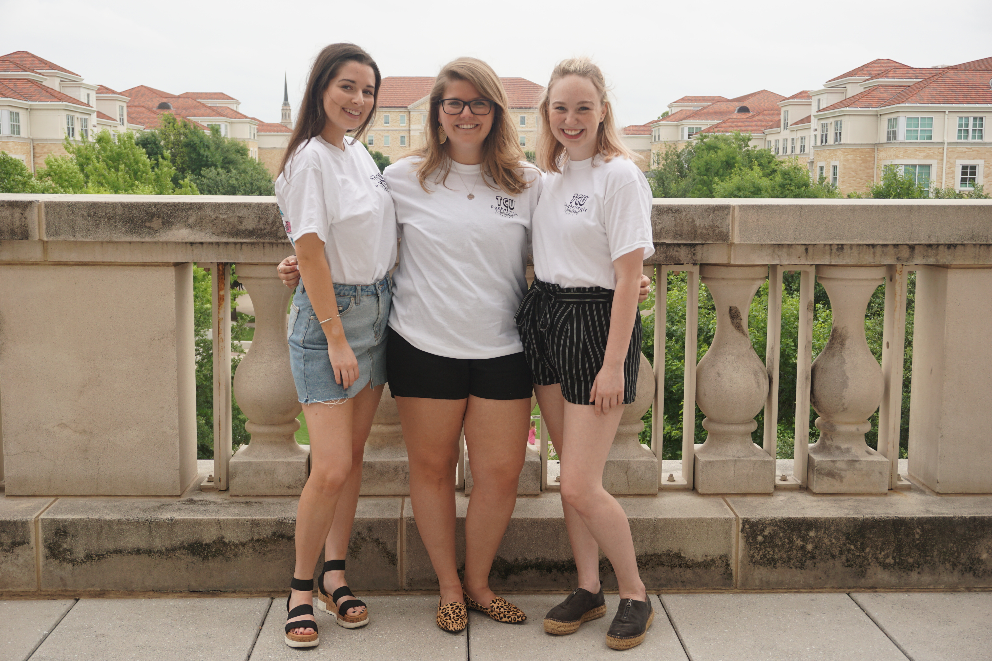
What to Wear: Round 1 (Days 1 & 2)
What to wear: PNMs will receive T-Shirts for Rounds 1 and 2. Wear this with any cute bottoms like casual shorts to wear as bottoms
Shoes
Closed-toe shoes are strongly recommended but not required!

Slide 29
What to Wear: Round 2 (Days 3 & 4)
What to wear: PNMs will receive T-Shirts for Rounds 1 and 2. Wear this with any cute bottoms like casual shorts to wear as bottoms
Shoes
Closed-toe shoes are strongly recommended but not required!

Slide 30
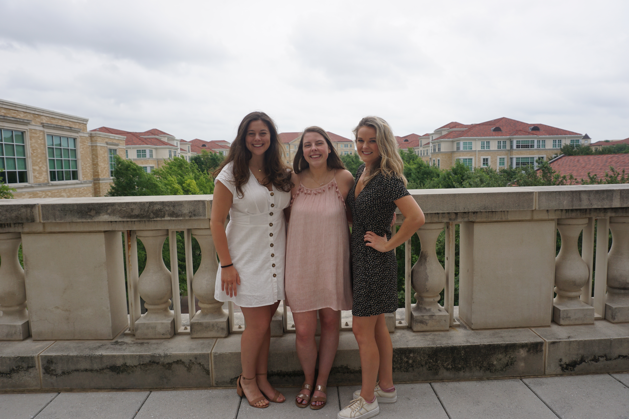
What to Wear: Round 3 (Days 5)
What to wear: Sundress, nicer blouse & skirt, and sandals or wedges
Closed-toe shoes are still recommended for walking, but can change before entering chapter houses

Slide 31
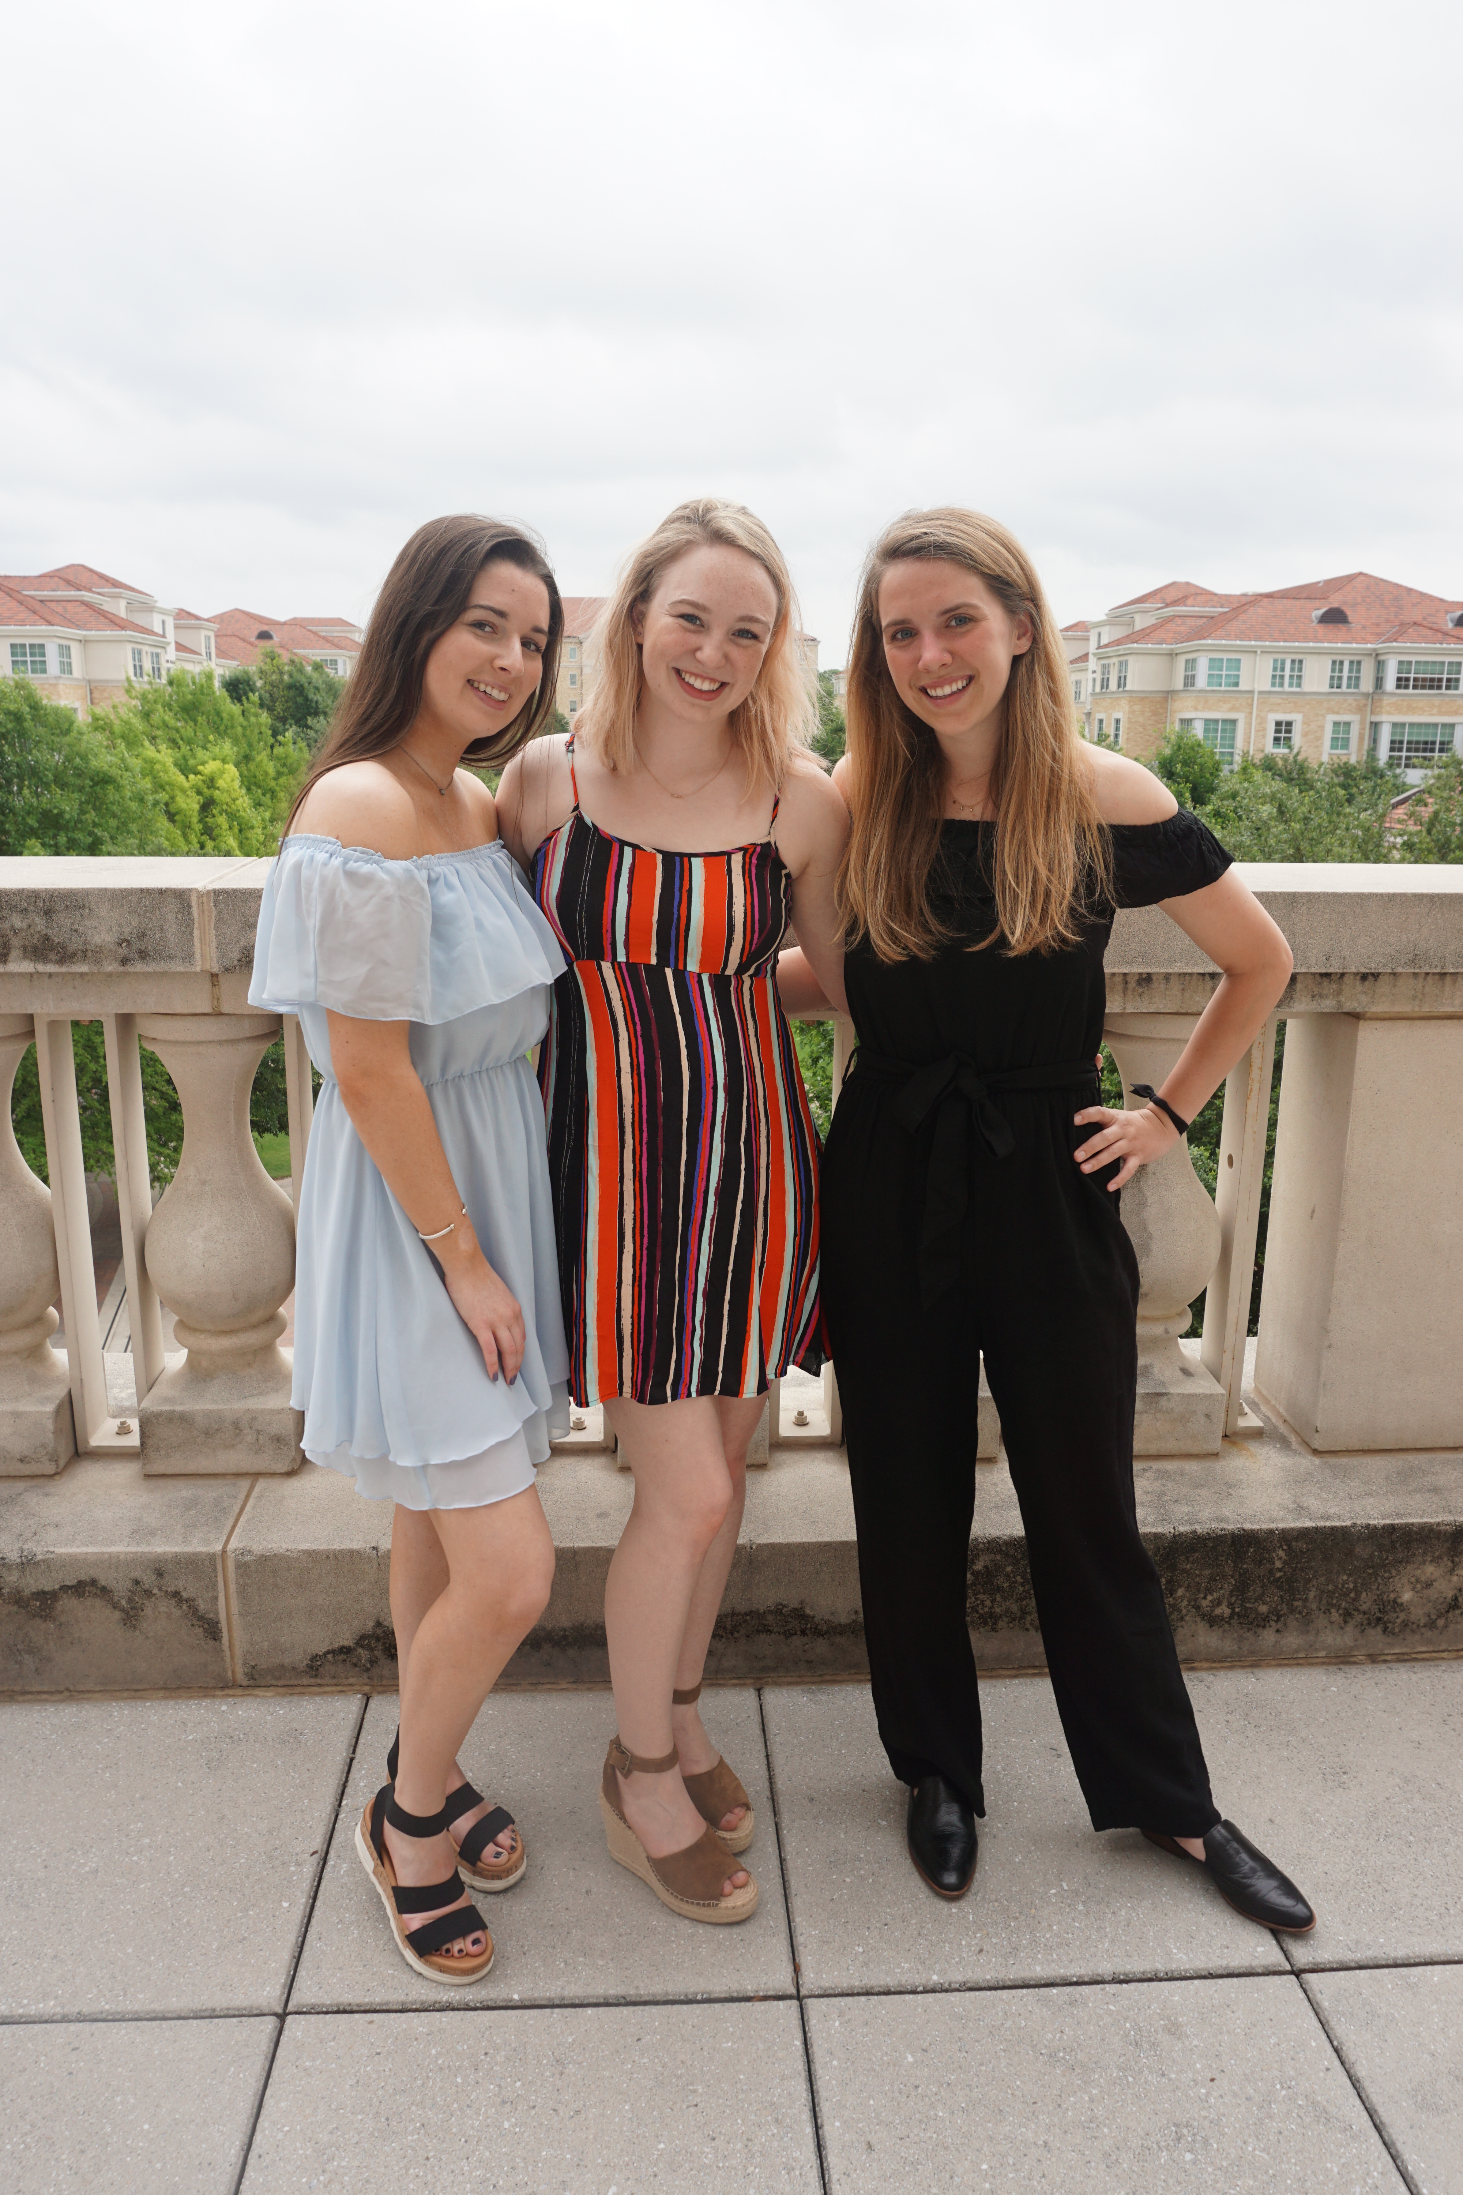
What to Wear: Round Four (Day 6)
Most dressy of the rounds; nice dress and heels or wedges are recommended
Still strongly recommended to bring closed-toe shoes and will be able to change before entering chapter houses

Slide 32
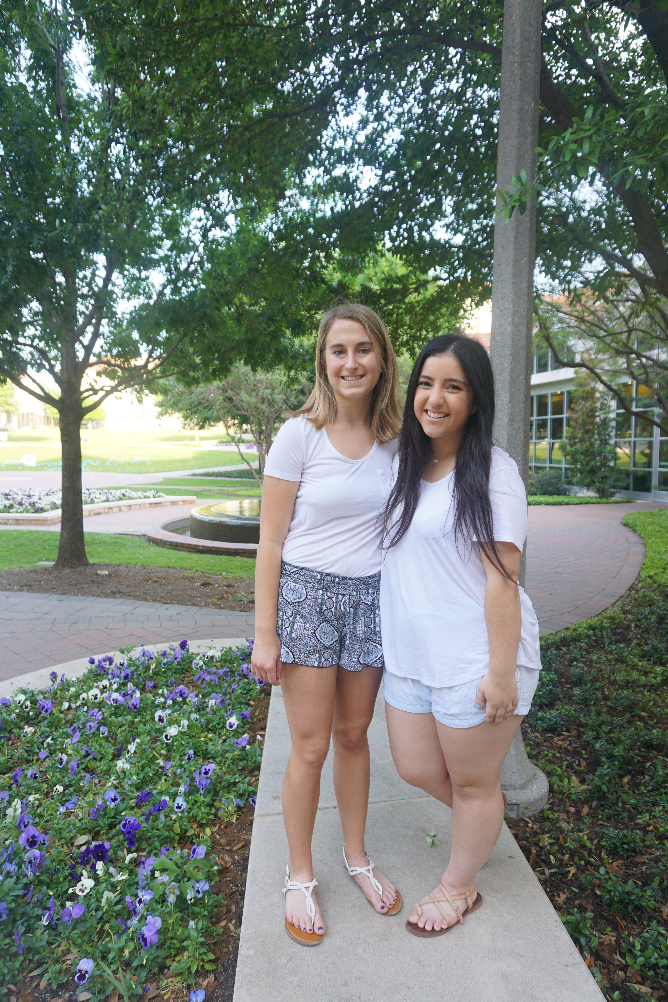
What to Wear: Bid Day
A plain, white T-shirt or tank top with comfortable bottoms and shoes. The shirt or tank top must be comfortable enough to put a T-shirt over it. The PNM can put her new chapter shirt on after she leaves the TCU Commons

Slide 33
Continuous Open Bidding (COB)
Some chapters MIGHT informally recruit members throughout the fall and spring – this is not a guarantee and we will not know which chapters will host fall/spring recruitment until September or January
On average 2-3 organizations will participate in COB but it varies from year to year; nothing is guaranteed.
Invitations to informal events are at the individual organization’s discretion.

Slide 34
What if I still have Questions?
Check out the Recruitment Booklet online on our website at www.tcupanhellenic.com
If you have any questions go to the “contact us” page on our website and we will do our best to get back to you within 24 hours
Like the ‘TCU Panhellenic’ Page on Facebook
Follow TCU Panhellenic on Instagram and Twitter at @TCUPanhellenic
Use the hashtag #TCURecruitment2019

Slide 35
What if it is an Emergency?
PNM Hotline: 817.471.5762
Parent Hotline: 817.470.1315
Office of Fraternity & Sorority Life: 817.257.7281
TCU PD: 817.257.7777

Slide 36
Tips for Parents
Encourage your daughter to keep an open mind. Do not pressure her to join your organization or the organization you think is the “best”.
If her favorite chapter is not on her schedule, encourage her to attend the events, she can withdraw at any time. Nothing is binding until she signs the MRABA.
There are MANY other ways to be involved on campus. Help encourage her to find her niche at TCU.

Slide 37
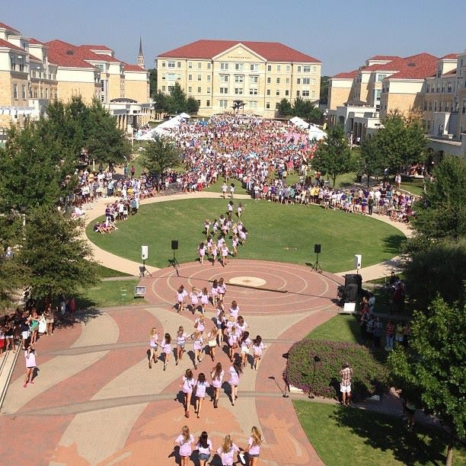
Any Questions?

